Slide 1
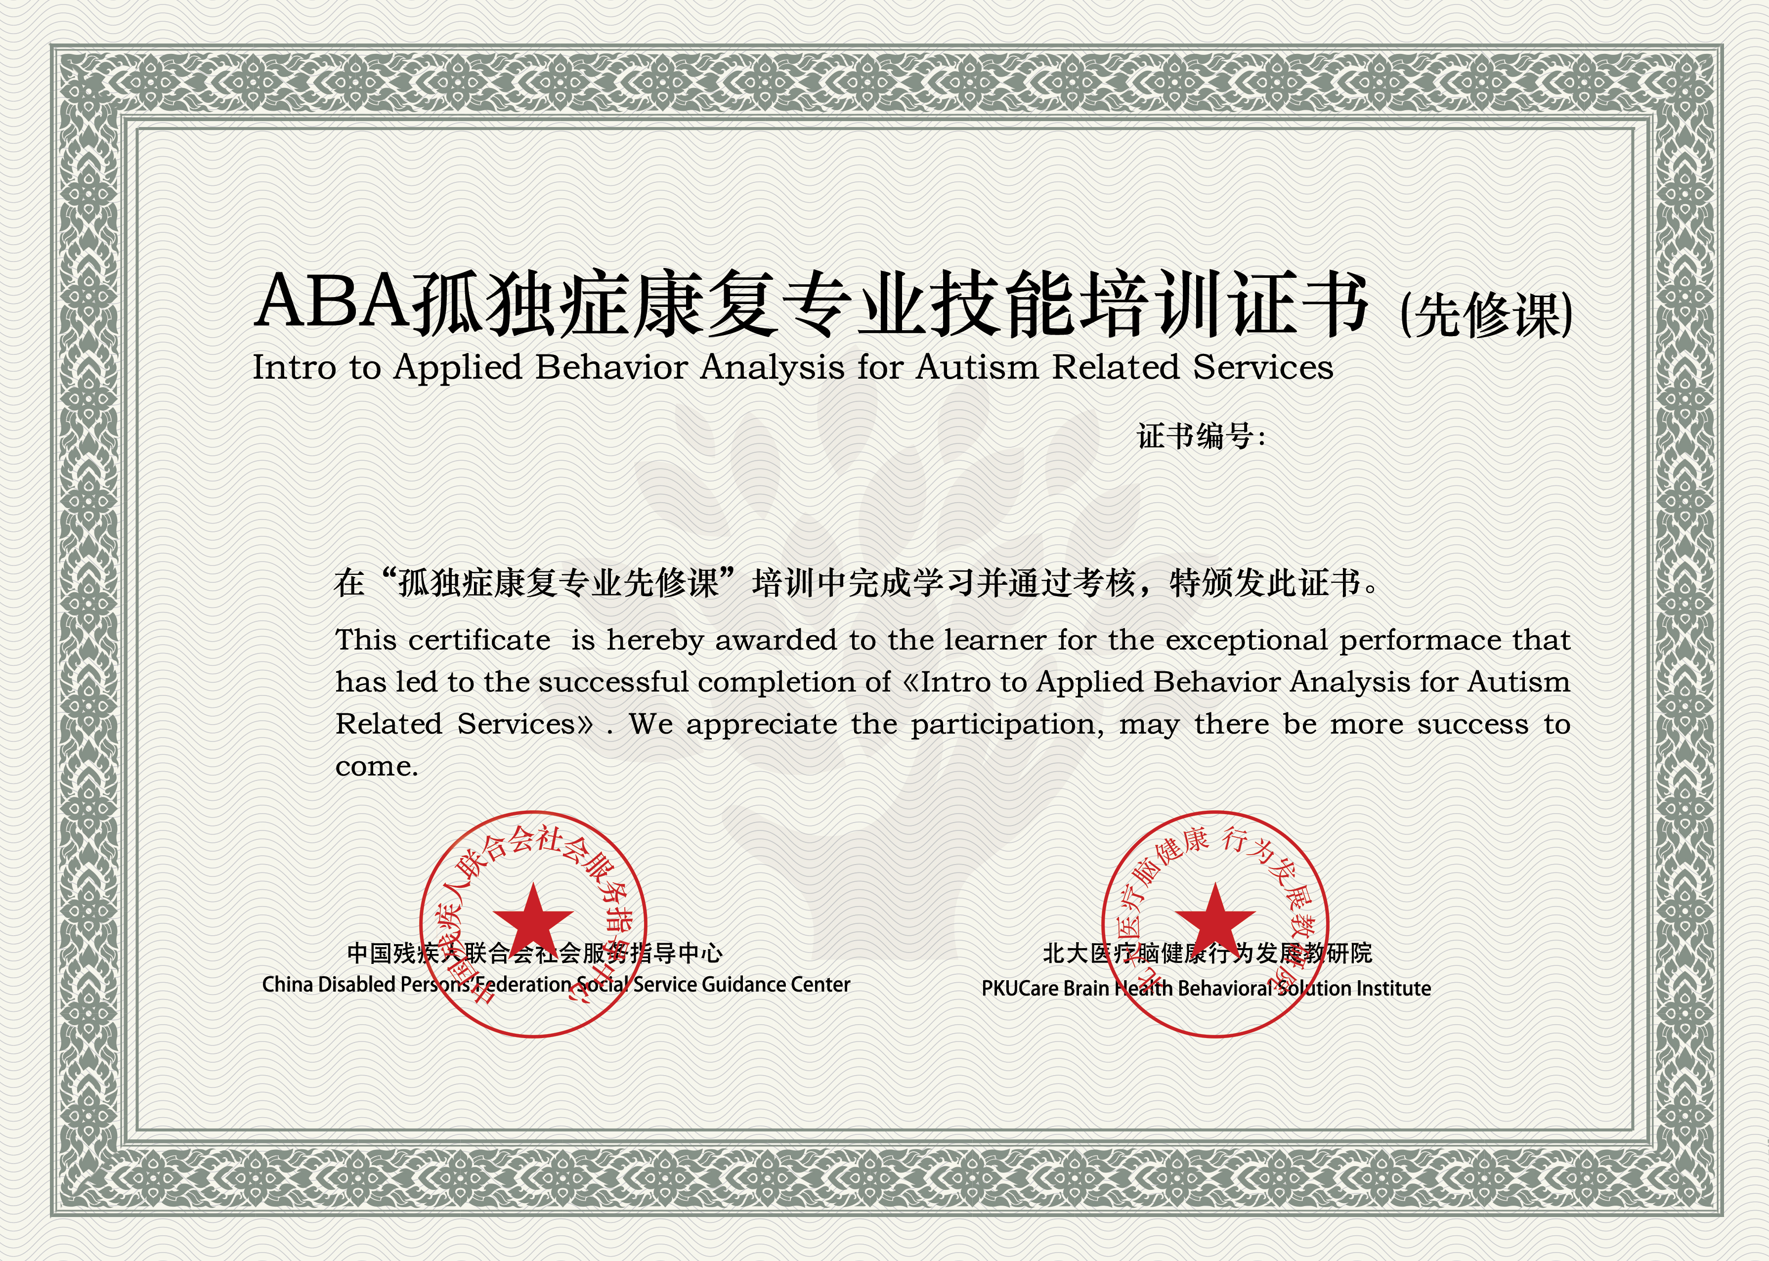
ABA-Intro2019-000000
张三
issueTime

